Slide 1
How do I work with the librarian?
Lane Medical Library Nursing Liaison

Slide 2
Who is the nursing librarian?

Slide 3
Connie Wong, DVM, MLIS

Slide 4
How do I ask for help?
You can always contact the Lane Medical Library by calling 650-723-6831 or emailing laneaskus@stanford.edu.

Slide 5
Level 1: Quick questions
Question
Answer:
Do we have this resource? (Journal of Nursing, Textbook on Nursing, etc.)
How can I get the full text of this article?
Email Connie Wong directly
hongnei@Stanford.edu

Slide 6
Level 2: Some sort of literature search
Question
Answer
Can you help me find articles on a topic?
I want to find systematic reviews, guidelines, or policy papers on a topic.
Complete the Literature Search Service form:
http://bit.ly/LaneLitReviewService

Slide 7
Literature Search Service Form
Enter your complete email with appropriate ending (Stanford.edu or stanfordhealthcare.org)
Select other type of review or project.

Slide 8
Literature Search Service Form
Indicate the aim of your project. If none of the options fit, please select other and explain what you want to accomplish with your project.

Slide 9
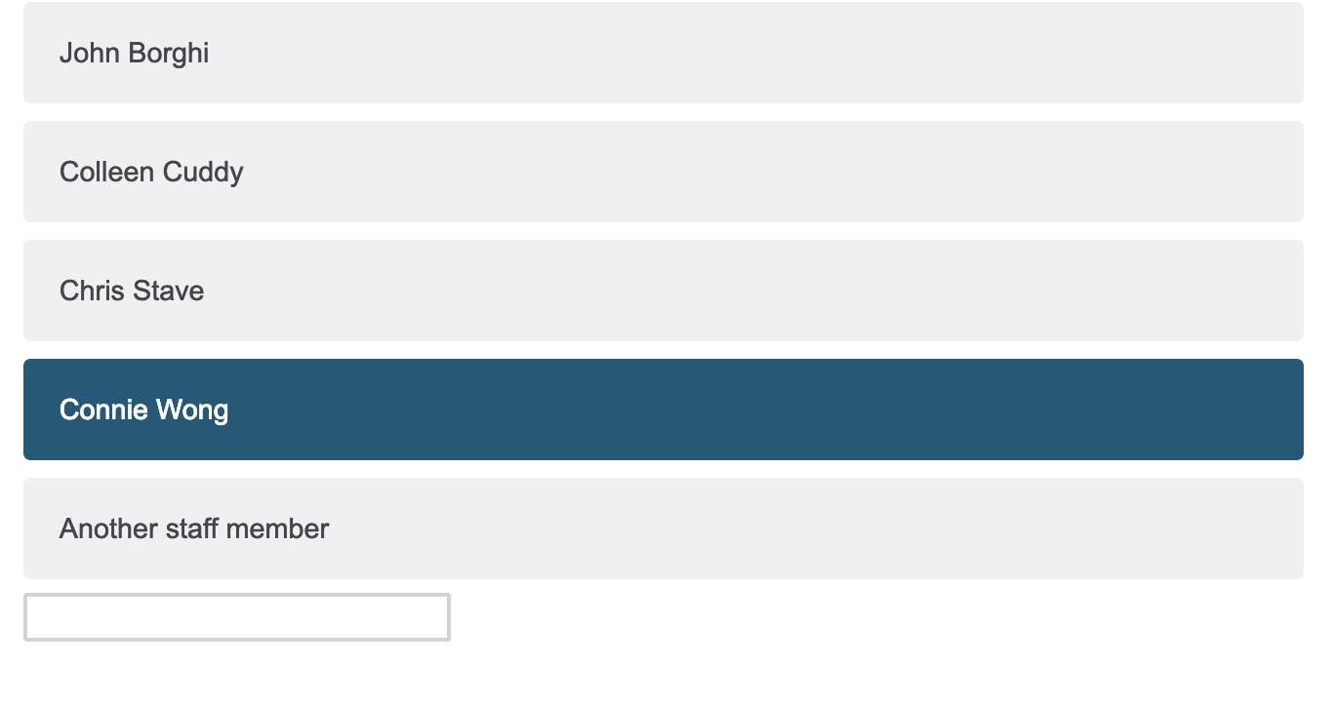
Literature Search Service Form
Select Connie Wong as the library staff person you have contacted about the project.
Fill in your timeline. Please be realistic with expectations.
Getting a search to you tomorrow if you request at 5pm the day before is not realistic.

Slide 10
Literature Search Service Form
Indicate whether you want to meet in person with Connie or not. It is okay to say no.
Fill out the fields regarding the project question the best you can. Doesn’t have to be perfect.
If you are using acronyms, like CHG, please spell out the complete name at least once (Chlorhexidine Gluconate).

Slide 11
Literature Search Service Form
If you have any date range or population limits you’ll want to put on the project, share them here.
If you know the methodological framework for your project, select the appropriate guideline. If unknown, it is fine to say I’d like to discuss with a librarian.

Slide 12
Literature Search Service Form
If you are using a citation management system, please share it here.
If you are using a review management software tool, please share it here.

Slide 13
Literature Search Service Form
Business days at the Lane Medical Library are Monday through Friday. Please know that your requests are important to Connie but we all have different working hours. She will get in touch with you about next steps within two business days.

Slide 14
After you submit the request
Either via the form or a direct email.

Slide 15
Next steps will depend on whether or not Connie understands your question
If you have a really clearly defined question with specific criteria, it is very possible that Connie can just put together a search strategy for you and share it via email.
However, Connie likes to check in before she starts doing a search to make sure she understands the question. Thank you in advance for answering her follow-up questions so she can help you most effectively.

Slide 16
Connie puts together a search strategy
The two databases Connie will do an initial search strategy creation for you are
PubMed
CINAHL
These databases are the beginning of your literature review
If you want a more thorough investigation of the topic, you have to meet with Connie in person or via Zoom

Slide 17
What do I do with the search strategy?
Connie has sent you an email with search terms in database syntax

Slide 18
Putting Strategies into Databases
Copy and paste.

Slide 19
What Connie will tell you in the email
She will provide the database syntax AND tell you what database it is for
Database Syntax Example
PubMed
((((nurs*[tiab]) OR "Nurses"[Mesh])) AND ((((health knowledge OR health attitude* OR health practice* OR attitude to computer*[tiab]))) OR (("Health Knowledge, Attitudes, Practice"[Mesh]) OR "Attitude to Computers"[Mesh]))) AND ((((EHR[Title/Abstract] OR electronic health record*[Title/Abstract] OR electronic medical record*[Title/Abstract]))) OR "Electronic Health Records"[Mesh])

Slide 20
Start at Nursing SHC Portal
http://lane.stanford.edu/portals/SHC-nursing.html
Select appropriate database from the databases column

Slide 21
PubMed
Copy and paste the syntax from the email into the search bar
Hit the search button

Slide 22
You will then see the results

Slide 23
Change the Format from Summary to Abstract
In the upper left hand corner, above the words search result, is the Format field.
Click on the small blue arrow to the right of the word summary. A drop down menu should appear.
Select Abstract (do not select the Abstract (Text))
This will change the view of your results

Slide 24
Database Syntax Example for CINAHL
(TI nurs* OR AB nurs* OR (MH "Nurses+")) AND ((TI ( attitude to computer* OR health practice* OR health attitude* OR health knowledge ) OR AB ( attitude to computer* OR health practice* OR health attitude* OR health knowledge) OR (MH "Health Knowledge") OR (MH "Attitude to Health+") OR (MH "Attitude to Computers")) AND ((TI ( EHR OR electronic medical record* OR electronic health record* ) OR AB ( EHR OR electronic medical record* OR electronic health record* )) OR (MH "Electronic Health Records") OR (MH "Patient Record Systems+"))

Slide 25
Go into CINAHL from SHC Nursing Portal

Slide 26
Copy and Paste Syntax
You do not have to select a field since the field tags will already be applied in the syntax.
Click on the search button.

Slide 27
CINAHL Results with Full Text Button

Slide 28
Getting full text of the article
In the abstract view in PubMed and the results view in CINAHL, you will see the Full Text @ Lane Library Stanford button under each article.
IF you do NOT see this button, it means you did not access PubMed or CINAHL through the Lane Medical Library Nursing SHC portal
You may also see a publisher full text button too.
You can click on any button to get to the full text. Sometimes the publisher button works and sometimes it doesn’t. The Full Text @ Lane Library Stanford button will always get you to the full text eventually but there might be more clicks involved.
If there is only a Full Text @ Lane Library Stanford button and you do not get to a full text version of the article by clicking through, you can request the article be delivered to you as a PDF using the DocXpress system

Slide 29
DocXpress https://docxpress.stanford.edu

Slide 30
DocXpress
If first time using, select Register option.
Review copyright information and click on I agree button.

Slide 31
DocXpress
Use your stanfordhealthcare.org or Stanford.edu email
For status, select Staff
For affiliation, select Stanford Hospital
For department, choose your department or Nursing
Username and password are not connected to SHC ID

Slide 32
If there is no digital full text access to an article
You will see this message
Click on Lane DocXpress

Slide 33
If there is no digital full text access to an article
Log in to your DocXpress account
The fields will be filled out for you by the system!
Only select rush service if needed for immediate patient care
For Scan on Demand, select No
Make sure you click on the Submit Request button

Slide 34
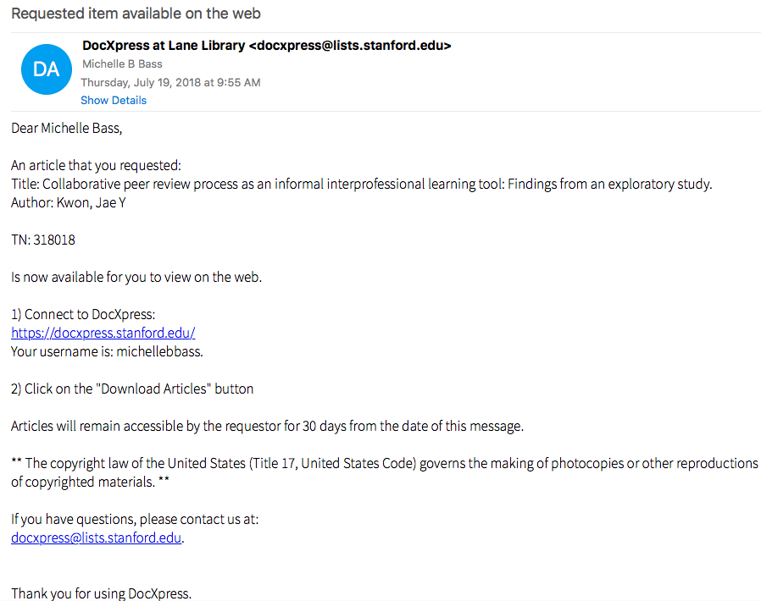
You will receive an email when the PDF is available

Slide 35
Make an appointment ORPCS
Once you have performed your literature review contact ORPCS to talk about your project
ORPCS can assist you with
Refining your aims
Project design
Data management
Data analysis
Dissemination
IRB
And so much more
ORPCS website:
www.orpcs.org
You can also email:
research@stanfordhealthcare.org

